Slide 1

Large-scale Ridesharing DARP Instances Based on Real Travel Demand
David Fiedler, Jan Mrkos
Department of Computer Science, Faculty of Electrical Engineering, CTU in Prague, Czech Republic.

Slide 2
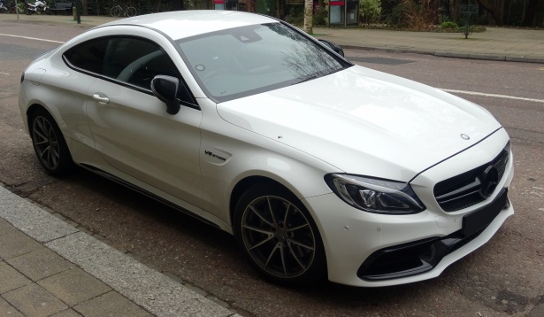

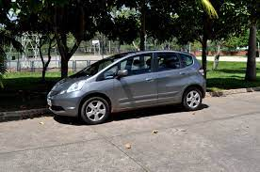
Mobility-on-Demand

Slide 3
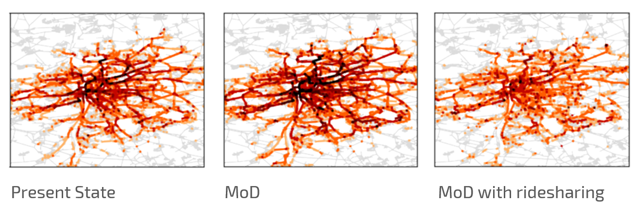
MoD Research
Better Dial-a-ride (DARP) algorithms for large-scale scenarios
Fleet-sizing
Case studies
For all that we need problem instances!

Slide 4
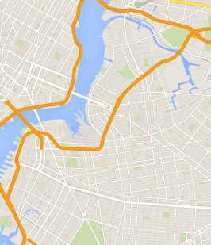


DARP instance
Vehicles
Initial location
capacity
Users
Pickup location
Drop off location
Desired pickup time
Time constraints
Travel time model

Slide 5
Difficulties of existing
DARP Instances

Slide 6
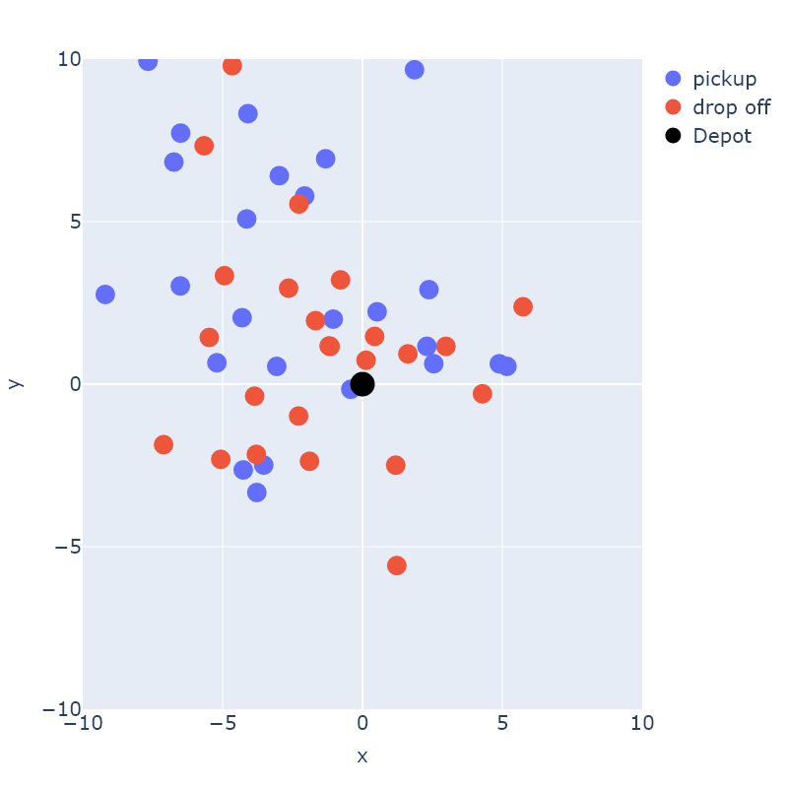
Classical Instances
<150
<10
Not representative of modern DARP problems!
Euclidean space
Representative example of a classical DARP instance. There is no road graph, the x and y axes are coodinates in Euclidean space.

Slide 7
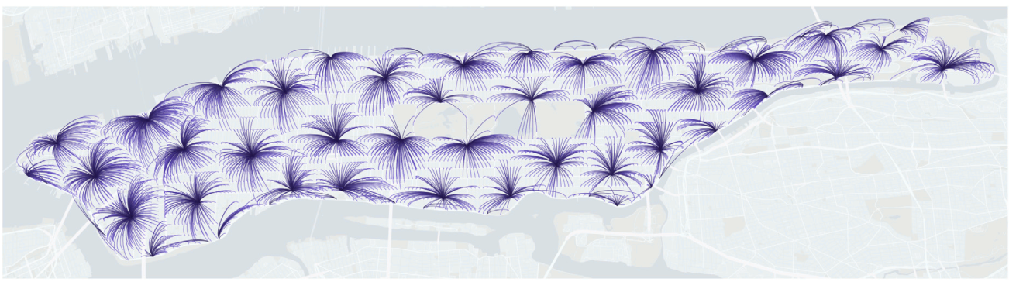
Currently used instances for MoD
Biased and irreproducible research
Large scale BUT…
Mostly based on old demand from Manhattan (pre-2013)
Instances (and solutions) are not public
[1] B. A. Beirigo, R. R. Negenborn, J. Alonso-Mora, and F. Schulte, “A business class for autonomous mobility-on-demand: Modeling service quality contracts in dynamic ridesharing systems,” Transportation Research Part C: Emerging Technologies, vol. 136, p. 103520, Mar. 2022, doi: 10.1016/j.trc.2021.103520.

Slide 8
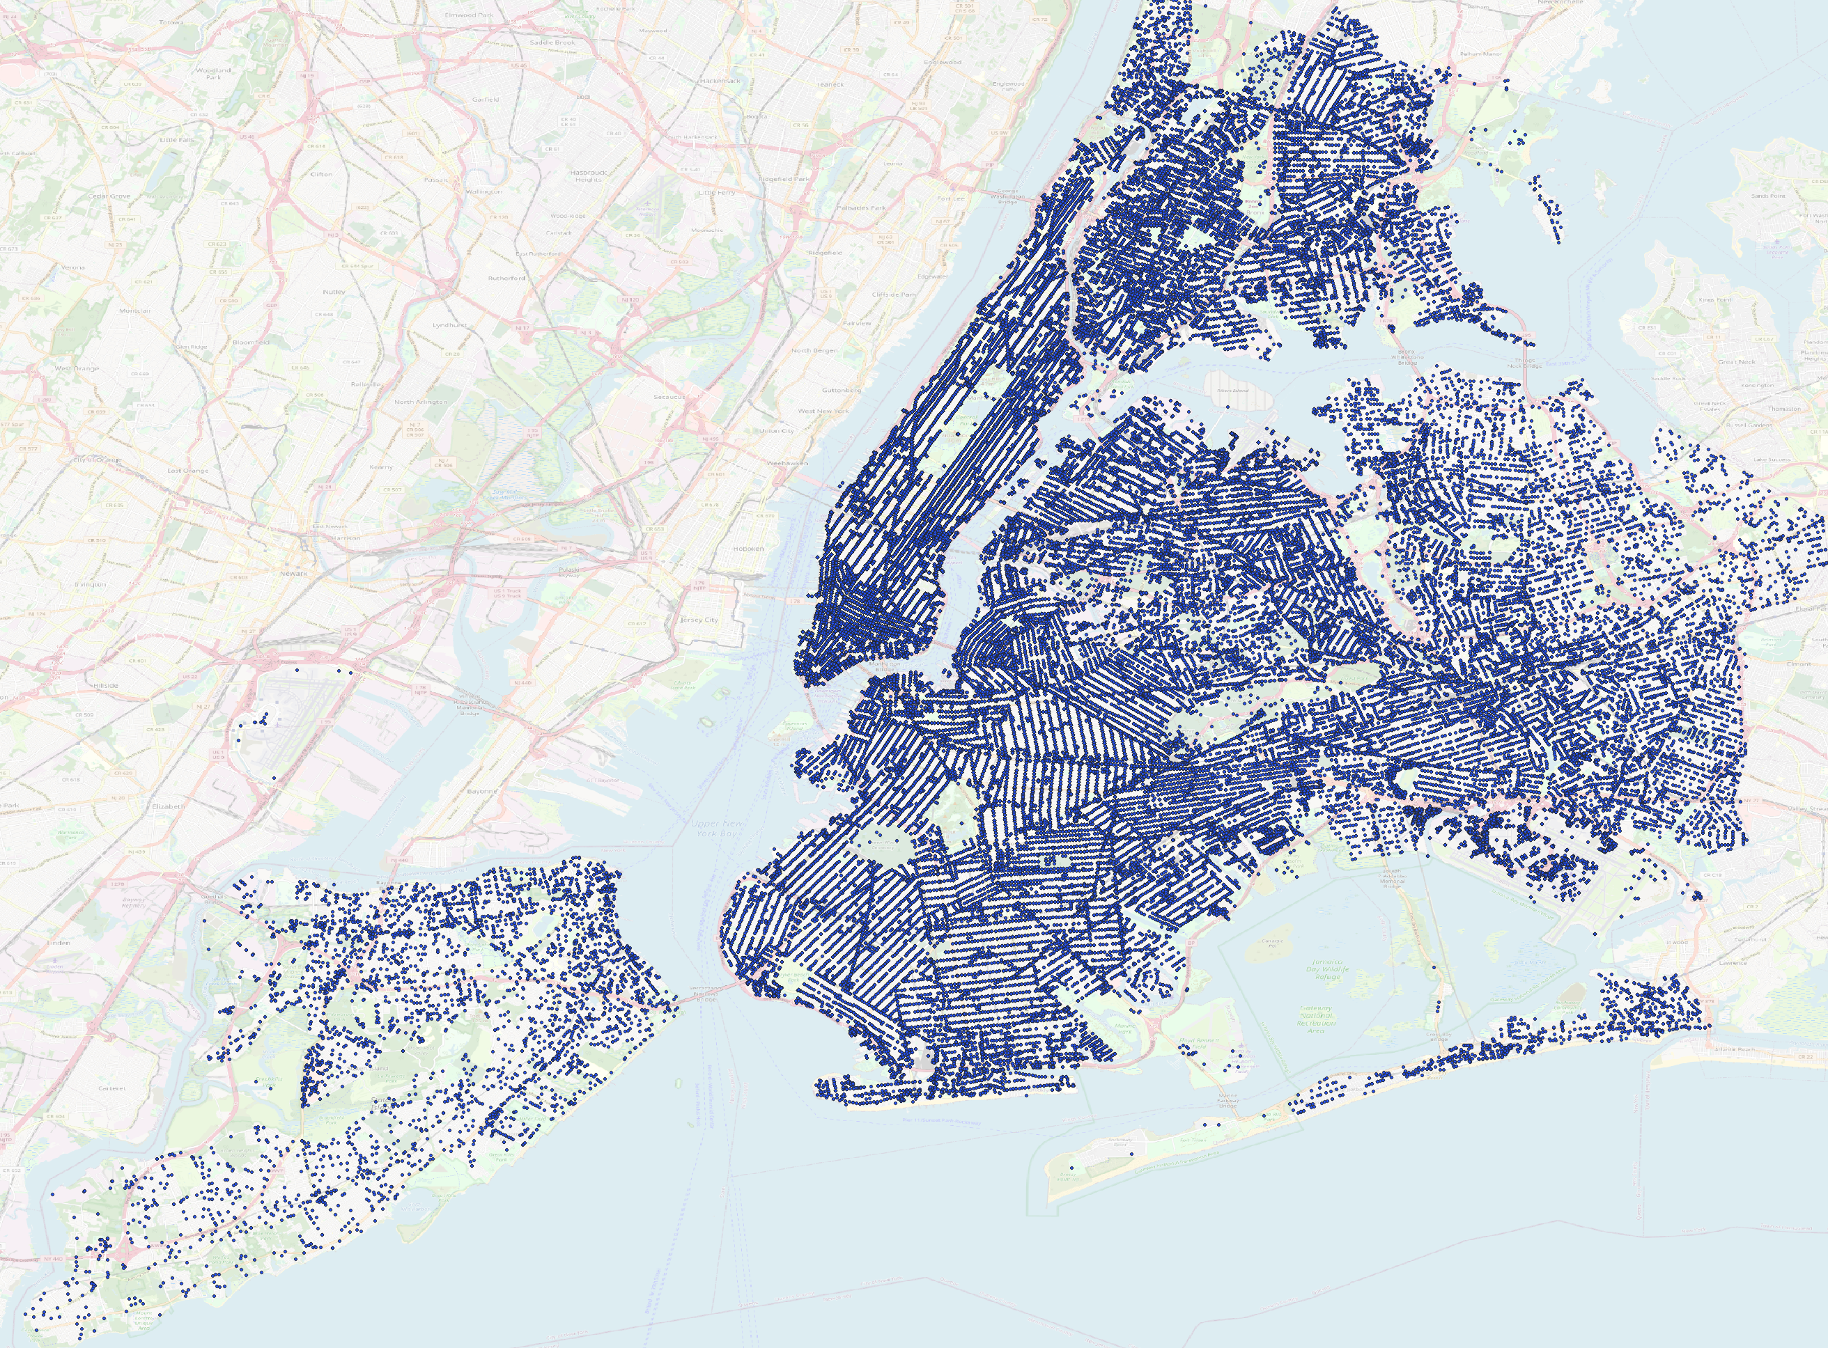
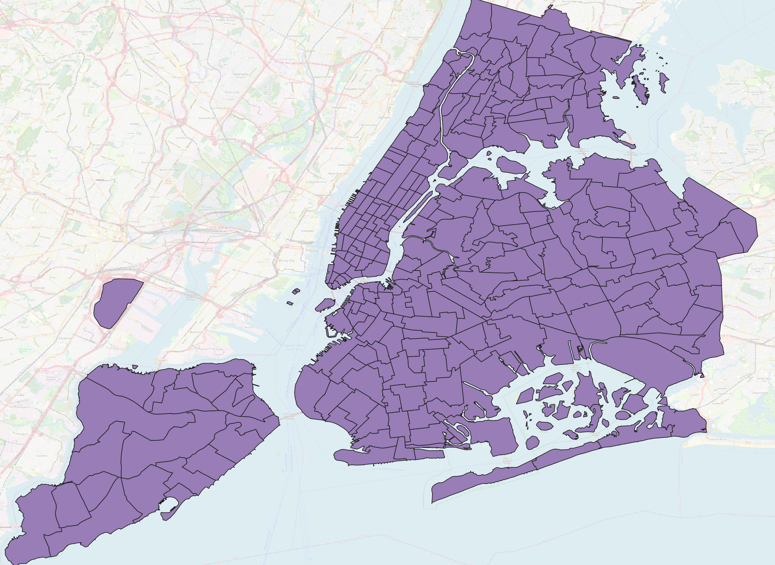
Why are 10-year-old data still used?
Before 2013
After privacy rules
19:48
19:45-20:00

Slide 9
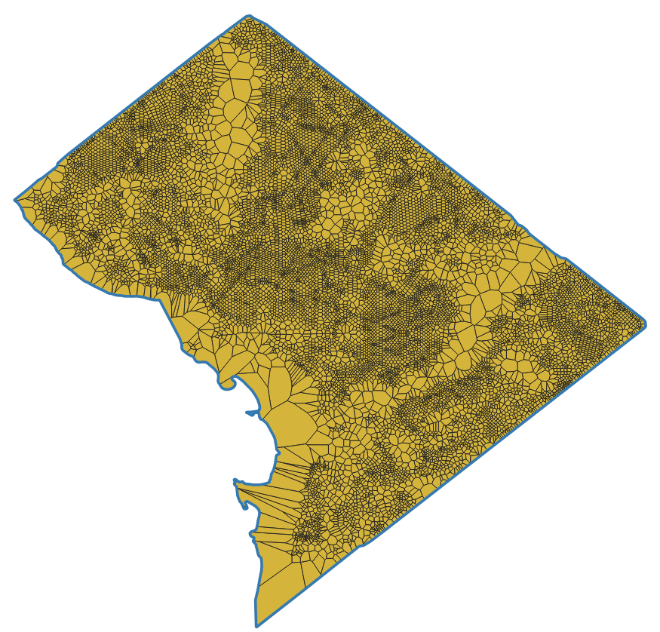
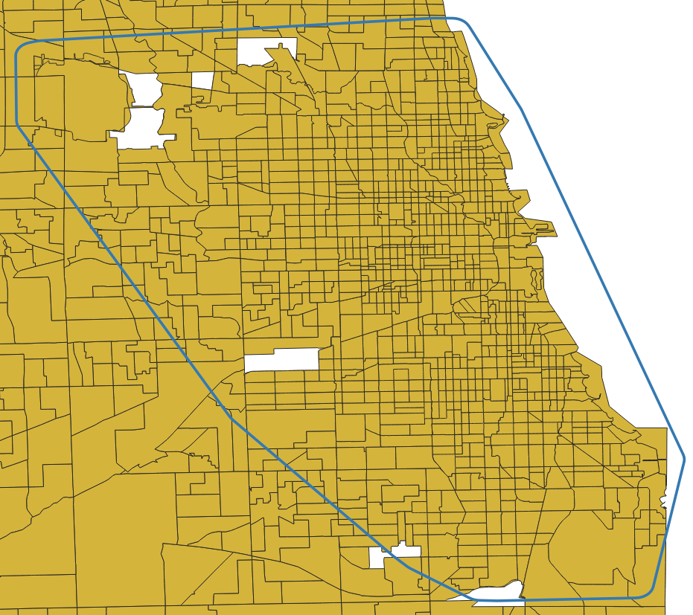
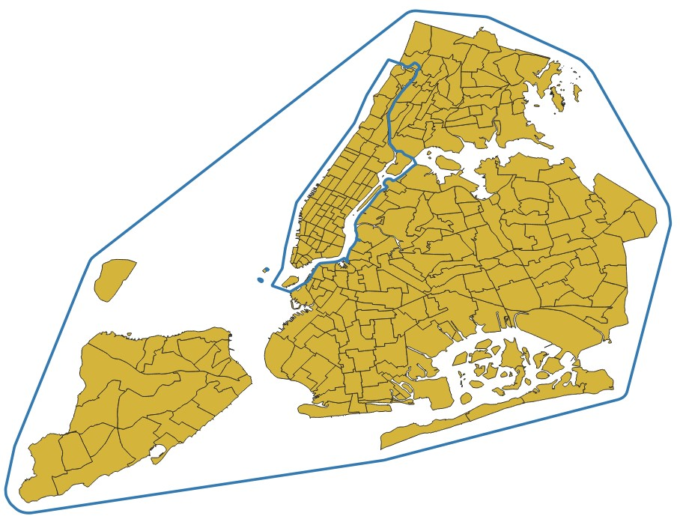
Challenges when modeling different areas
Data formats are not unified among cities
Different time intervals
Precise, various interval length
Different zone types and formats
NYC: taxi zones
Chicago: 2 types of mun. areas
DC: address points

Slide 10
Our proposed DARP dataset

Slide 11
Our proposed DARP dataset
Existing datasets
Proposed dataset
Pre-2013
Pre-Covid
Outdated traffic patterns
Latest available
Current travel patterns
Any time available
Data sources
Manhattan
Very high demand
Specific topology
4 areas
NYC, Manhattan, DC, Chicago
Varied topology
Locations
No
Unpublished data
Proprietary code
Yes
Full dataset available
Open source
Reproducible

Slide 12
New Instances Dataset
Areas: | NYC, Manhattan, Chicago, DC
Instance Duration: | 30 seconds to 16 hours
Max Delay: | 3, 5 and 10 min
Largest instance – NYC, 16 hours:
541 000 requests
6 600 vehicles
113 000 Nodes
281 000 edges

Slide 13
Brief methodology

Slide 14
Even briefer methodology
Uber Speed Dataset
Speed Processing
Open Street Maps
Map Processing
Instance
Fleet sizing
Zone Dataset
Demand Processing
Demand Dataset

Slide 15
Dataset contents

Slide 16
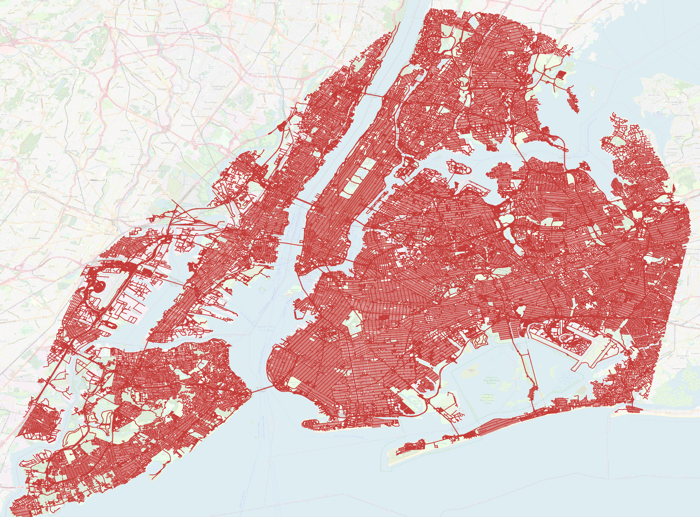
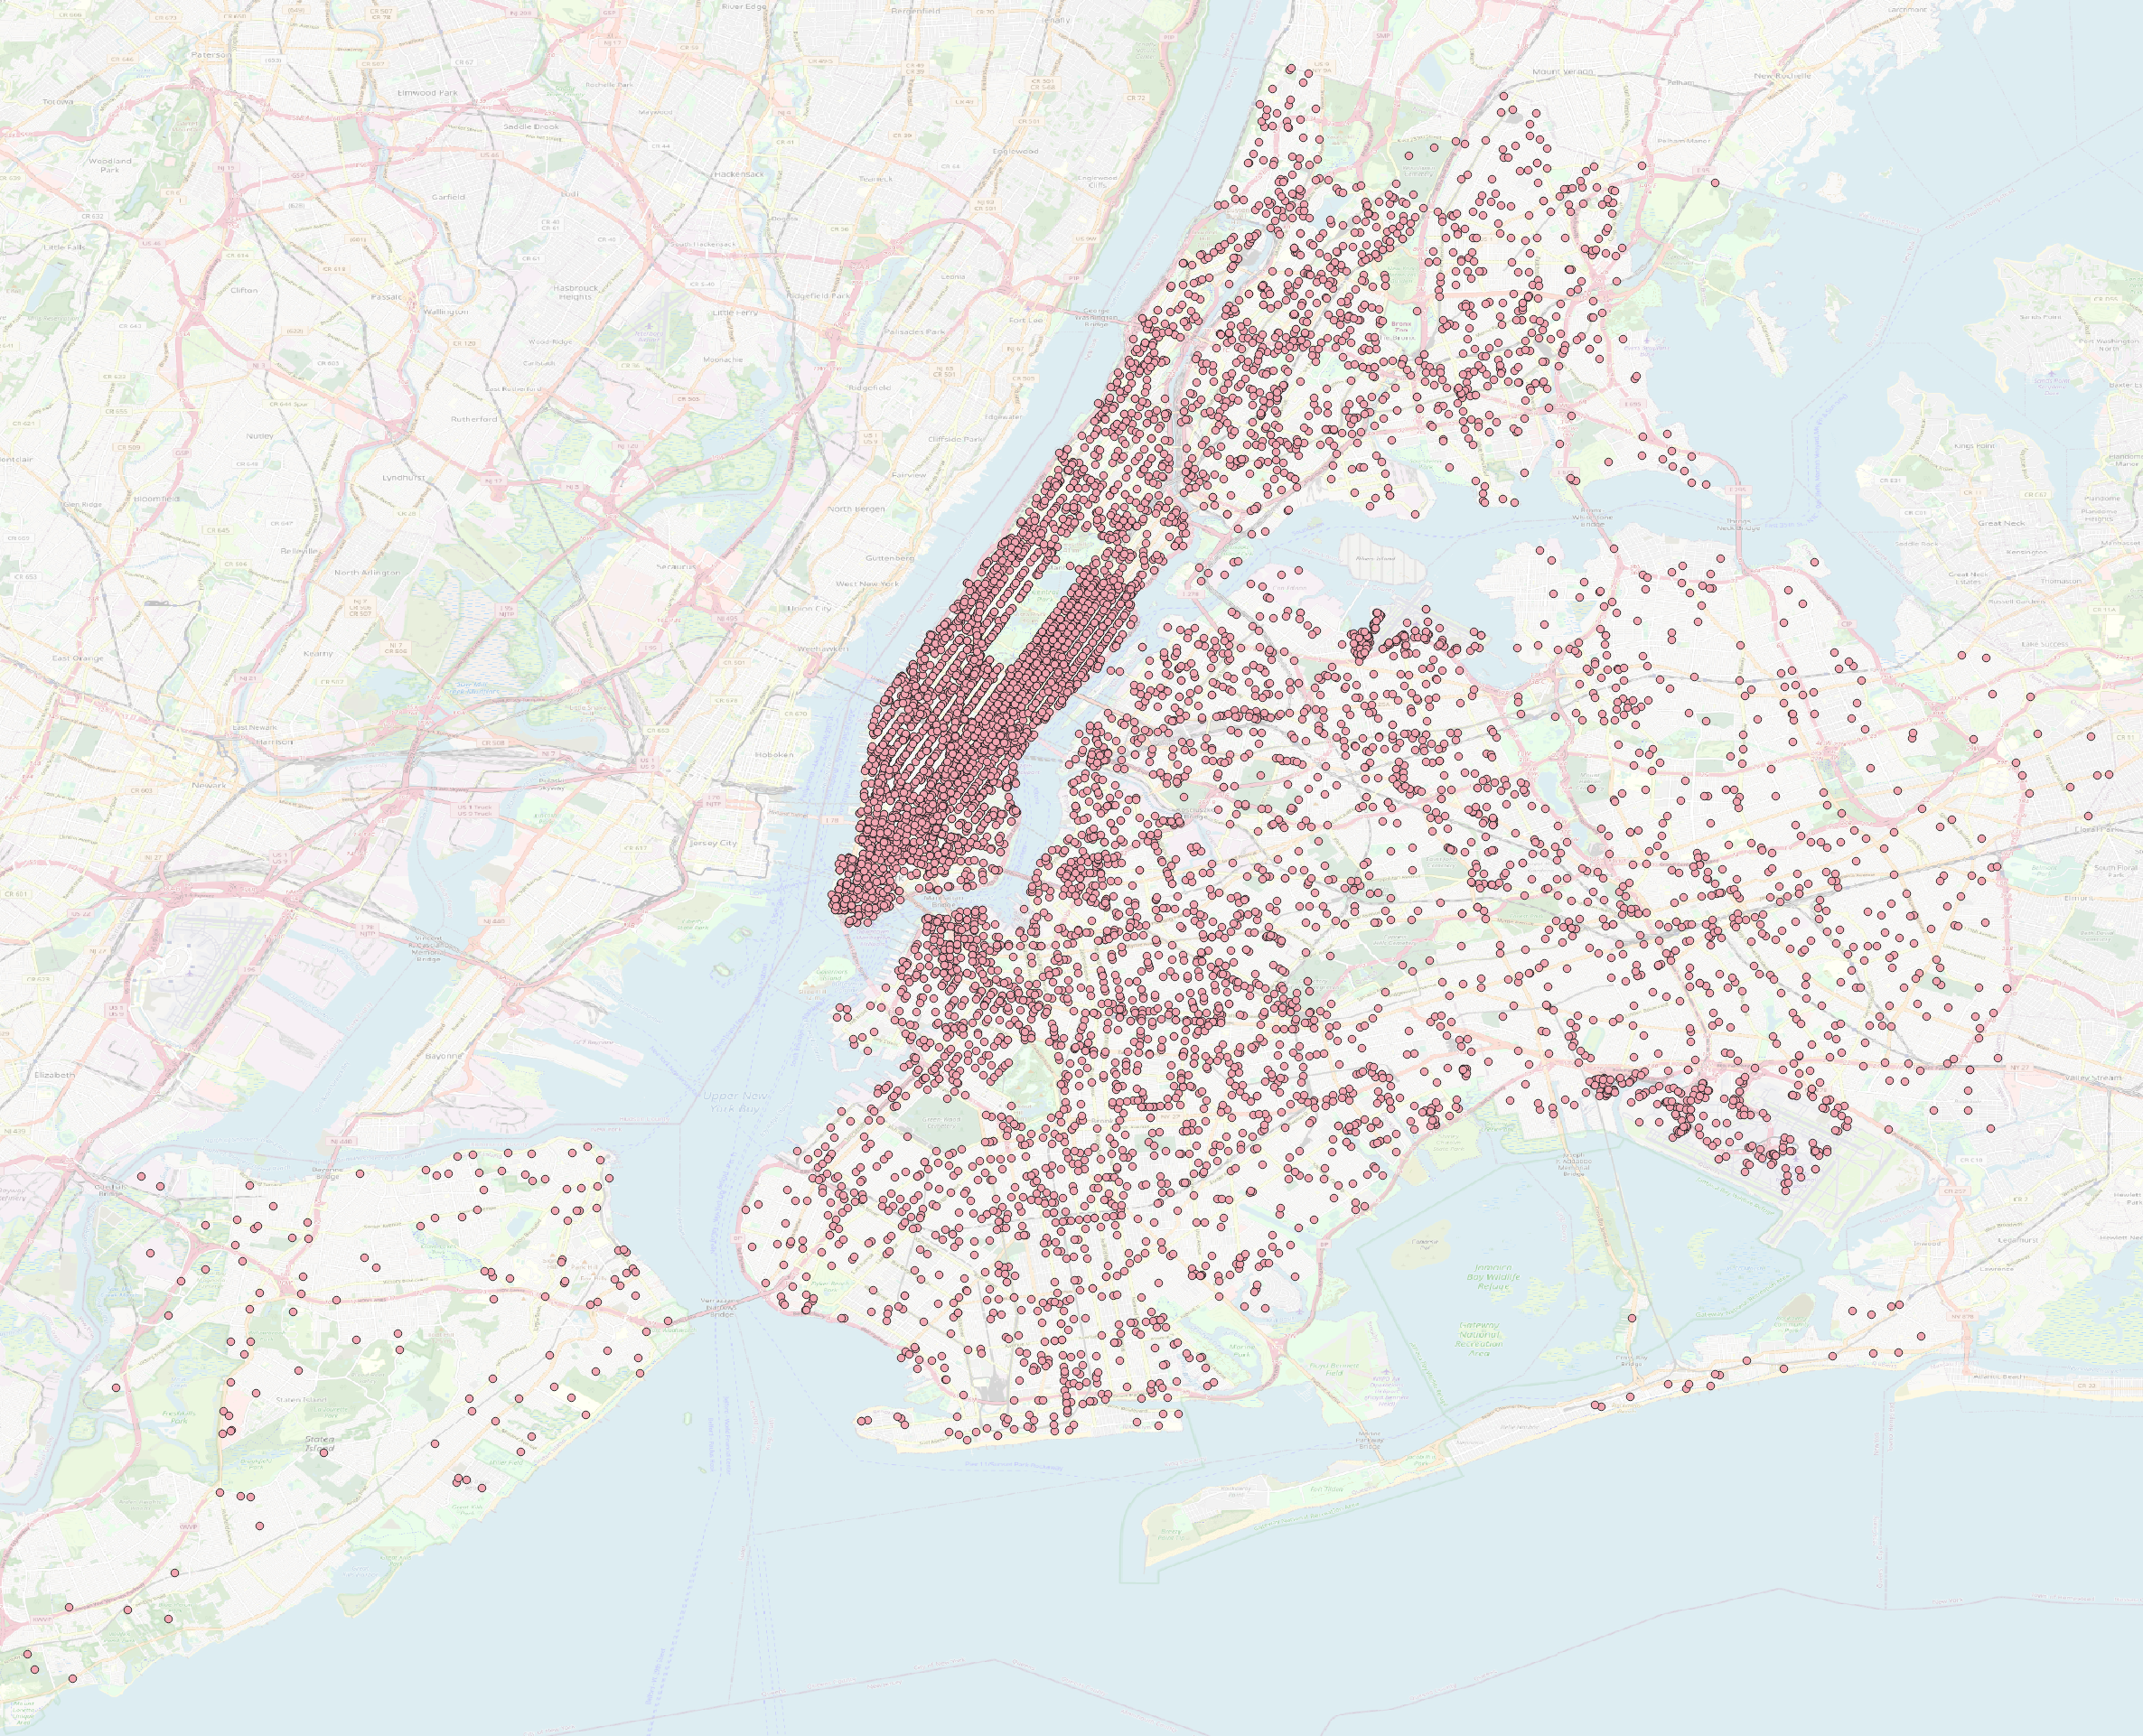
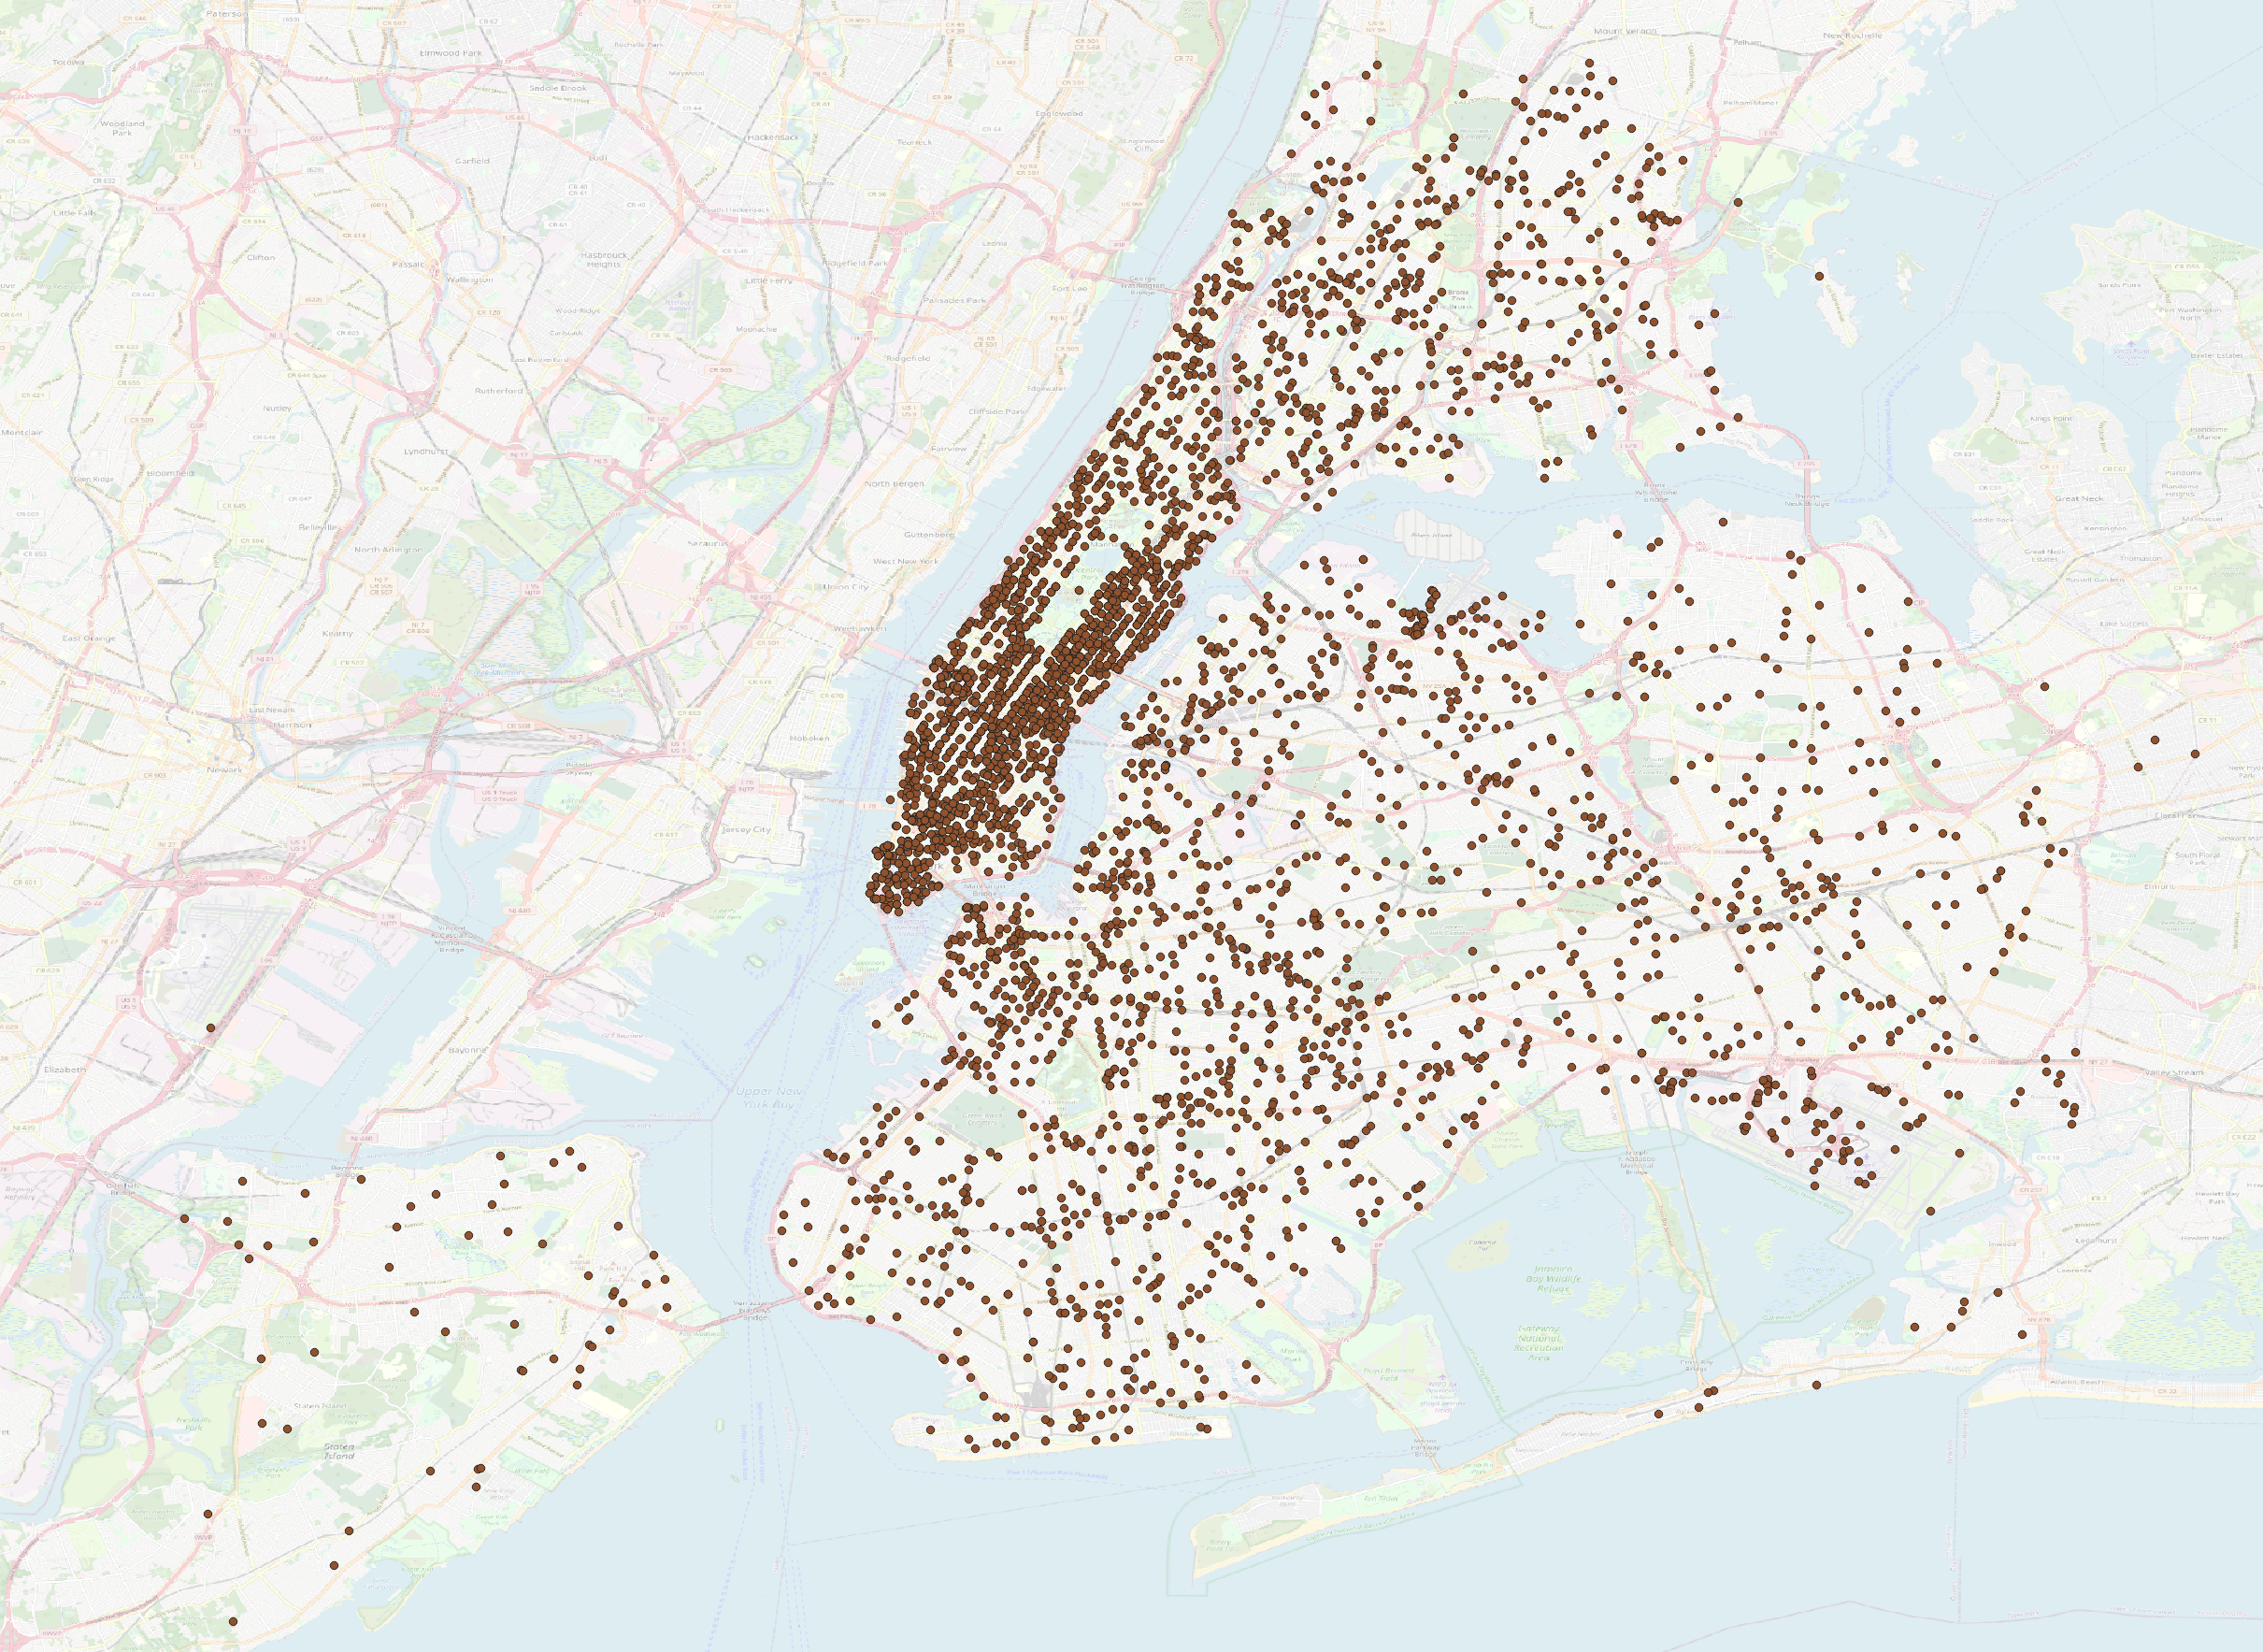
Content of an Instance
Map
csv
shapefiles
distance matrix with travel times
Demand
csv
shapefiles
Vehicles
csv
shapefiles
Allow easy visualization!

Slide 17
Ridesharing efficiency results
Two methods compared:
Insertion Heuristic (IH)
Vehicle Group Assignment (VGA) (optimal)
The optimal method is most beneficial on large instances (Manhattan, NYC)
Solutions published as well!

Slide 18


Possible use cases for the community
Evaluating DARP solution methods on large scale up to date instances
Comparison between cities
Instances can be used also to test solution methods for other problems (fleet-sizing, rebalancing,…)
New instances can be generated using the methodology, as the code is open sourced
https://github.com/aicenter/Ridesharing_DARP_instances

Slide 19
Content of solution
Solution file: json
Exact plan for each vehicle, including times of each action
List of dropped request
Performance file
Total computation time
Peak memory
Method specific metrics

Slide 20
Data Sources
Area name | Demand data source | Zone data source | Request times | req./h/km² | Avg. zone area [km²]
New York City | NYC Taxi and Limousine Commission | NYC taxi zones | exact | 27.52258 | 3.013094
Manhattan | NYC Taxi and Limousine Commission | NYC taxi zones | exact | 475.2113 | 1.038004
Chicago | City of Chicago | Census tracts and community areas | generated | 1.166358 | 1.337512
Washington, DC | City of Washington, DC | Master Address Repository | generated | 3.645636 | 0.013119

